Slide 1

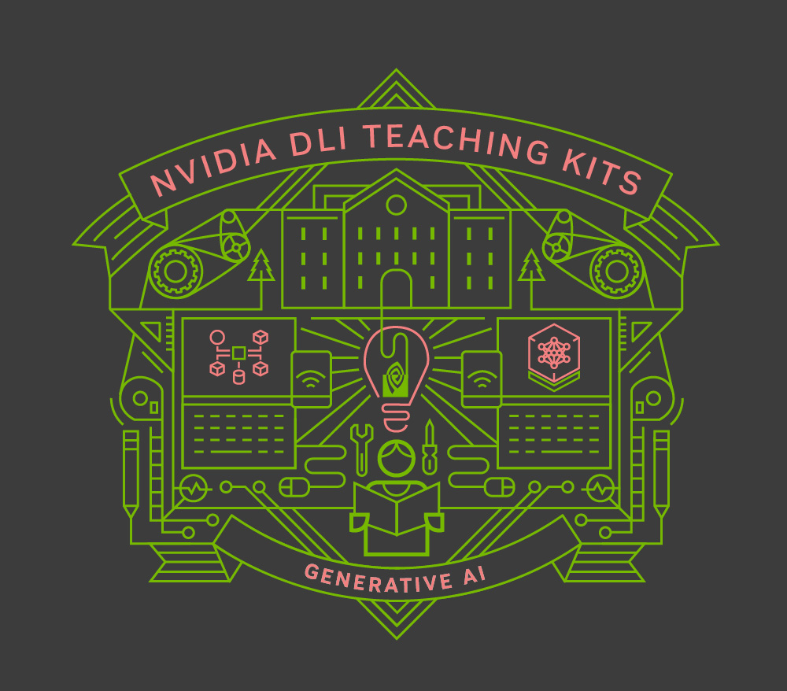
Lecture 8.3 LLM Agents
Generative AI Teaching Kit

Slide 2

The NVIDIA Deep Learning Institute Generative AI Teaching Kit is licensed by NVIDIA and Dartmouth College under the
Creative Commons Attribution-NonCommercial 4.0 International License.

Slide 3
This lecture
Reasoning with LLMs
LLM Agents
Aligning Agents with Guardrails
NeMo Guardrails and Meta Llama Guard

Slide 4
Reasoning with LLMs
Thinking slowly and carefully

Slide 5
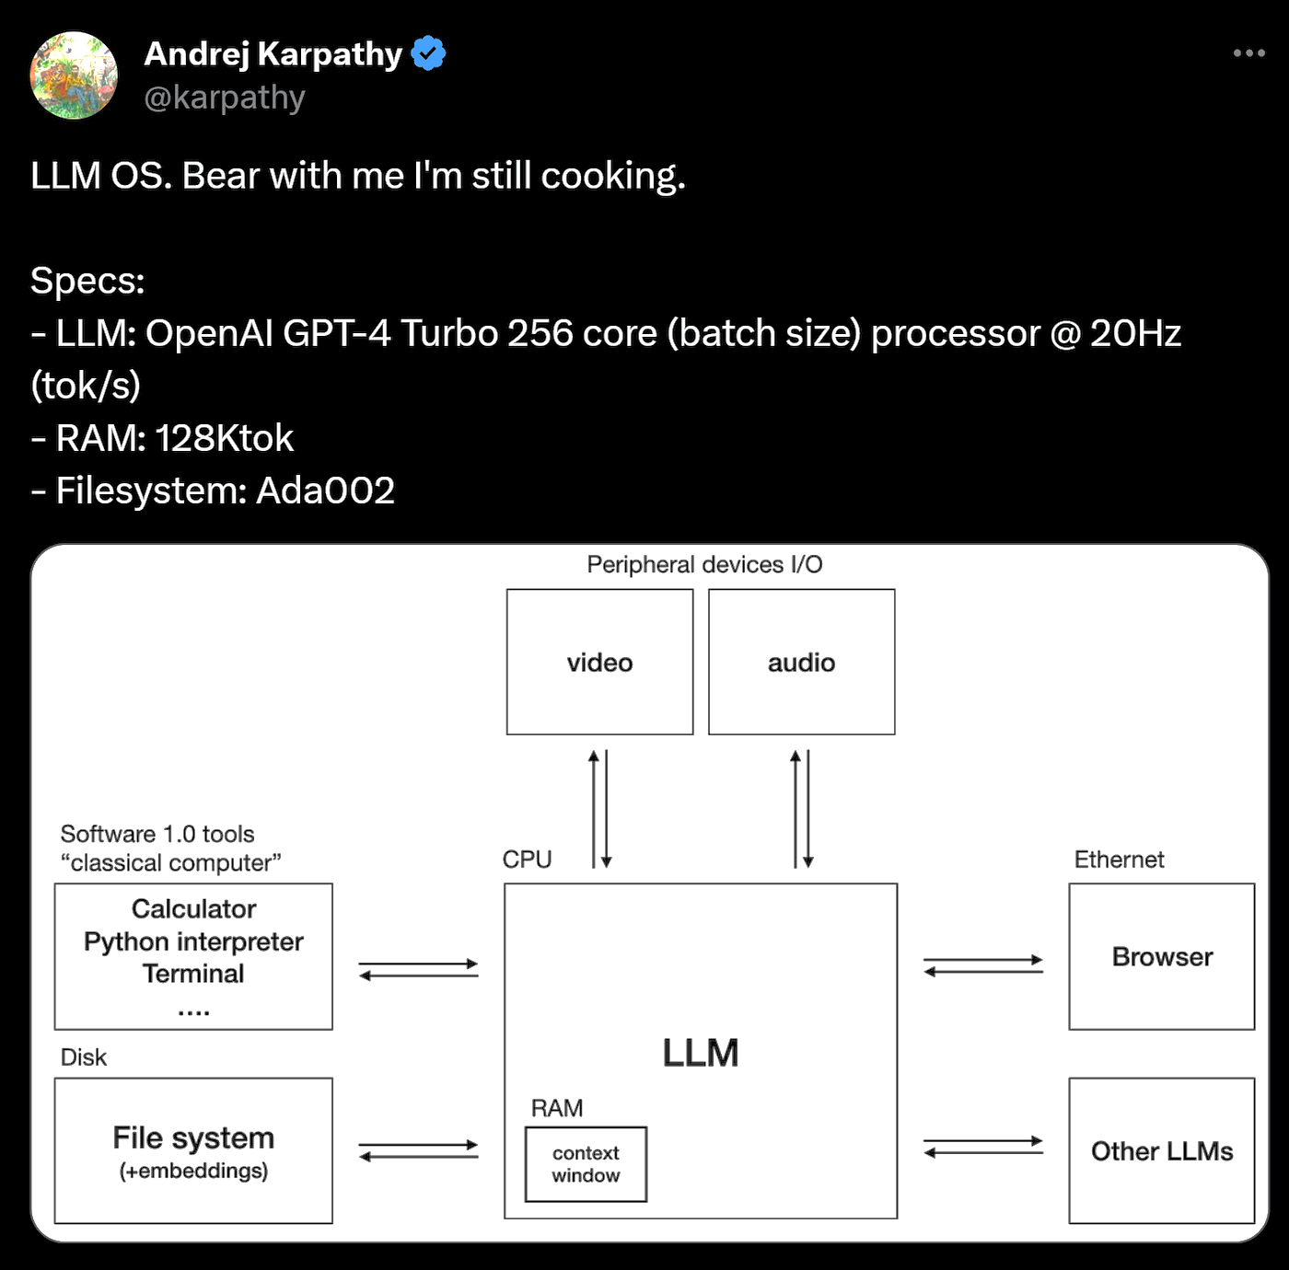
LLM Reasoning – What will LLMs do
So far we have seen how well LLMs can extrapolate information with in-context learning.
How much more can we push this? Could an LLM be used as a central processing/logical reasoning unit?
In this lesson we will explore how LLMs can be used as reasoning tools.
Andrej Karpathy, a thought leader in the LLM space, posited the LLM OS, which connects components to an LLM as a futuristic view of computing platforms.

Slide 6
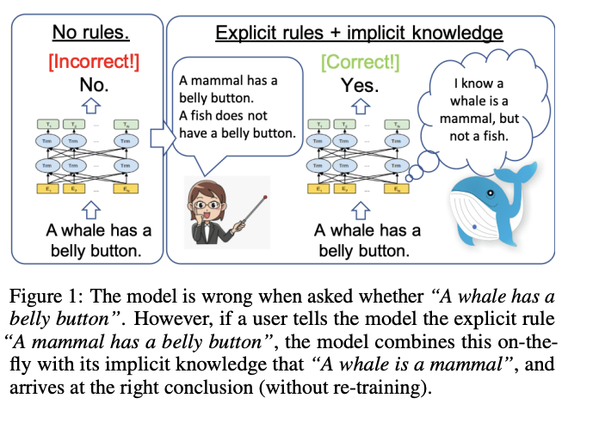
LLM Reasoning – Seeing LLMs reason
Reasoning in the context of LLMs refers to the model’s ability to:
logically connect pieces of information
draw inferences, and
make decisions based on the input it receives
Unlike simple pattern matching or text generation, reasoning involves a deeper understanding and manipulation of information to solve complex tasks or answer questions that require multi-step logic.
Reasoning enables LLMs to tackle complex tasks that go beyond the surface level, such as mathematical problem-solving, understanding cause-and-effect relationships, or making decisions based on multiple variables.
Notes:
https://arxiv.org/pdf/2006.06609

Slide 7
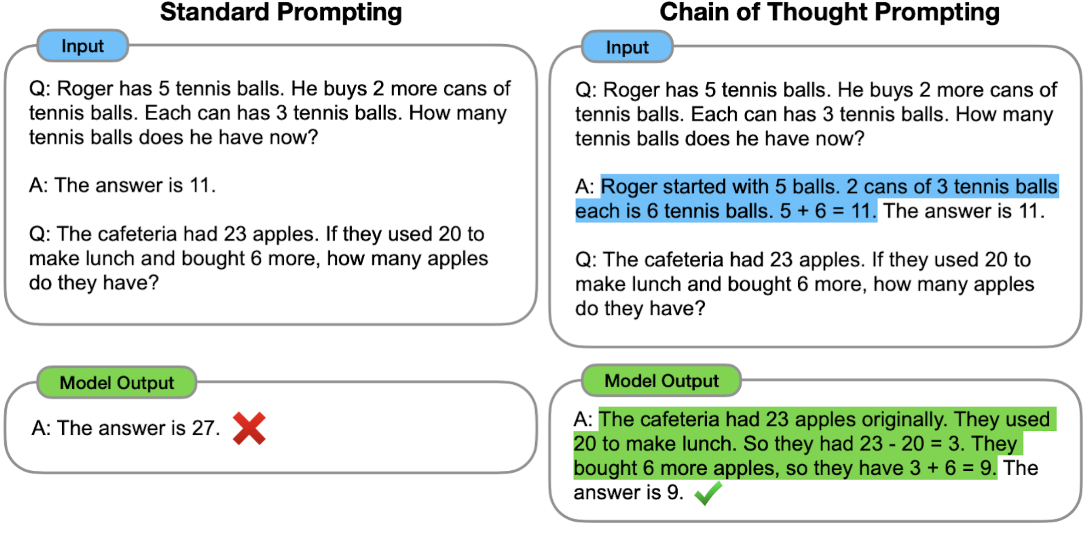
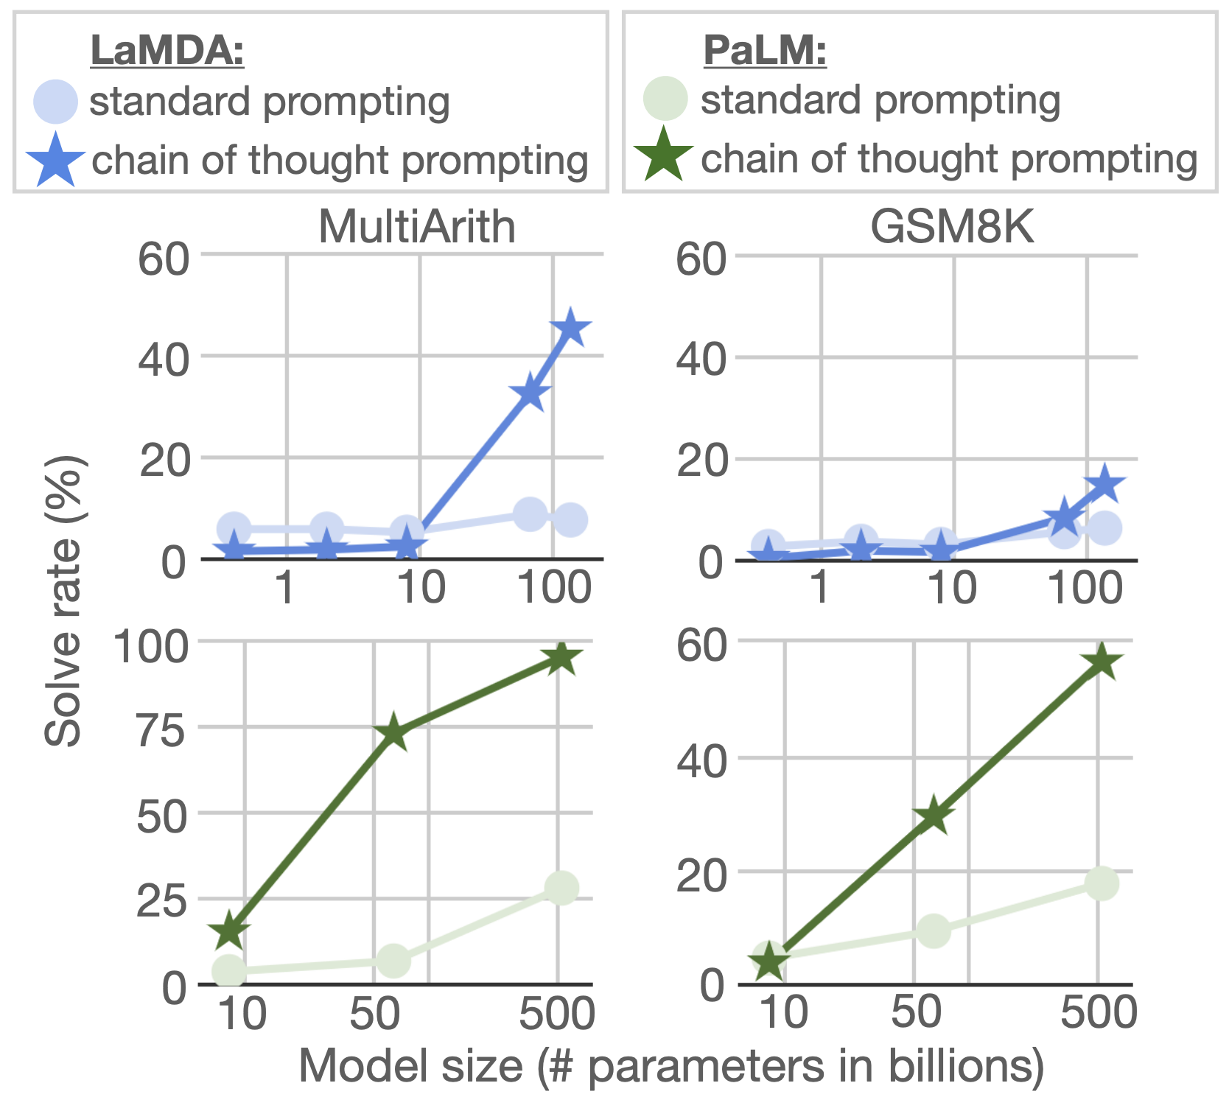
Chain-of-Thought Prompting
Chain-of-Thought (CoT) prompting is a method that allows the LLM to take multiple steps to solve a prompt.
By showing how to work through a problem step by step, the LLM learns to solve problems by breaking them down into pieces.
Since the output is fed back into the context, the model is able to attend over the logical flow of the problem’s solution.
Notes:
https://machelreid.github.io/resources/kojima2022zeroshotcot.pdf
https://research.google/blog/language-models-perform-reasoning-via-chain-of-thought/

Slide 8
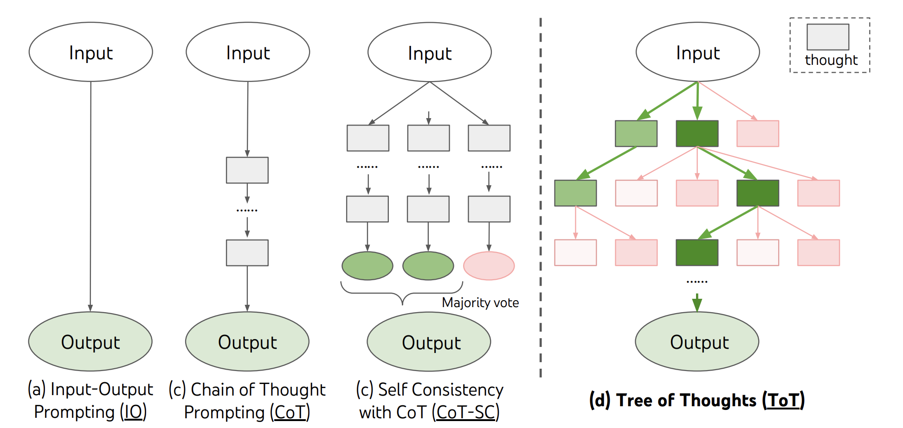
Tree-of-Thought Reasoning
Tree of Thought (ToT) is an extension of CoT, where the reasoning process is represented as a branching tree structure rather than a single chain.
ToT enables the exploration of multiple potential reasoning paths simultaneously, enhancing the ability to consider alternative solutions or hypotheses.
Application Scenarios: Highlight scenarios where ToT is advantageous, such as in decision-making tasks with multiple outcomes, game strategies, or tasks requiring the evaluation of different approaches.
Visualization: Use a tree diagram to illustrate how ToT works, with branches representing different reasoning paths that are evaluated and pruned based on their likelihood of leading to a correct or optimal answer.
Challenges: Discuss the computational complexity and the need for efficient path exploration and pruning strategies in ToT.
Notes:
https://arxiv.org/abs/2305.10601

Slide 9
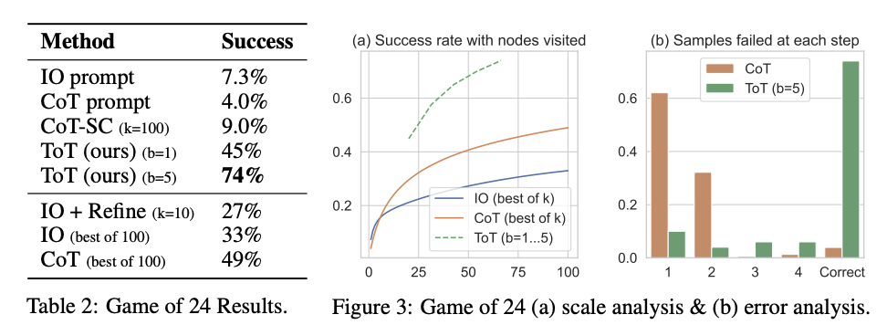
Comparing CoT and ToT
Chain- vs. Tree-of-Thought
Key Differences
Structure: CoT is linear, whereas ToT is hierarchical.
Application: CoT is better suited for linear, step-by-step reasoning tasks, while ToT excels in tasks requiring the consideration of multiple possibilities.
Complexity: ToT generally involves more computational overhead due to the need to evaluate multiple paths.
Combining CoT and ToT
Initial Broad Exploration (ToT): Start with Tree of Thought to explore multiple potential solutions simultaneously, identifying the most promising paths through branching and pruning.
Focused Deep Reasoning (CoT): Transition to Chain of Thought within the selected paths to conduct detailed, step-by-step reasoning, refining the solution with linear logic.
Iterative Refinement: Use an iterative process where CoT refines paths identified by ToT, and if issues arise, loop back to ToT to explore alternatives, combining broad exploration with deep analysis for optimal outcomes.
Notes:
https://arxiv.org/abs/2305.10601

Slide 10
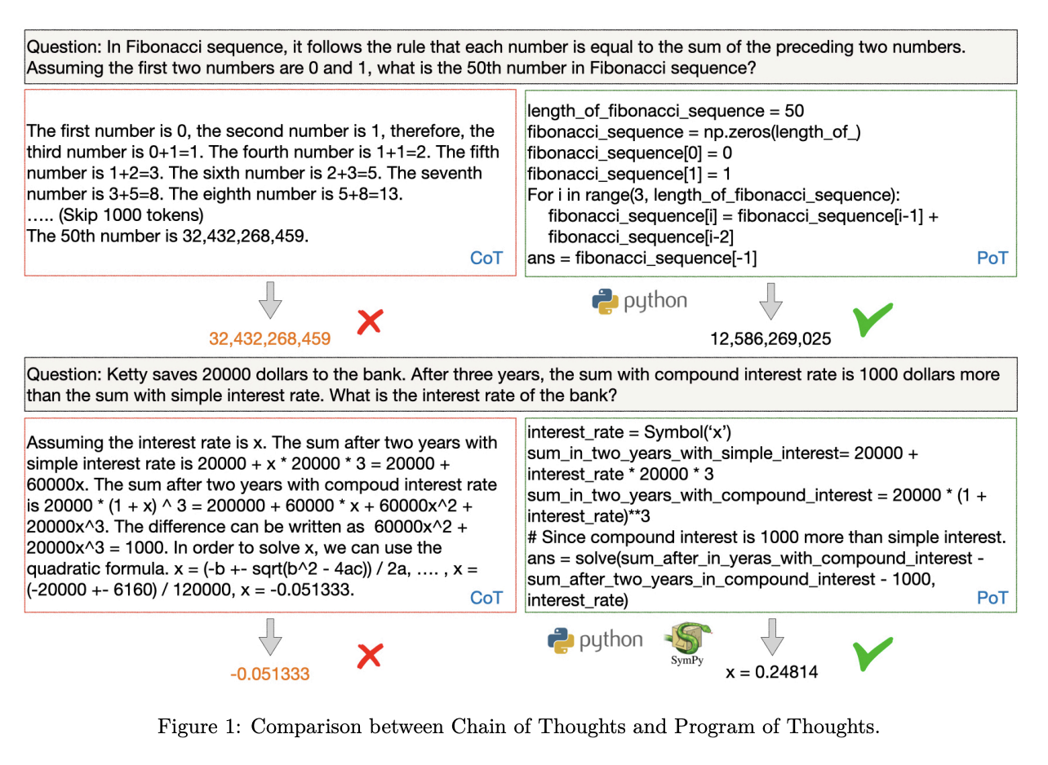
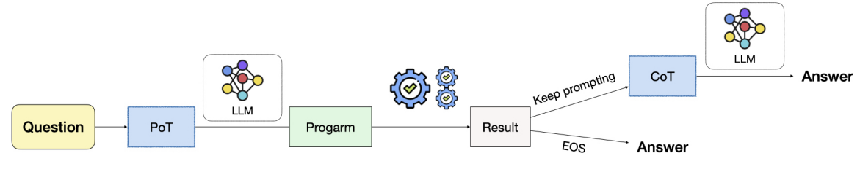
Program-of-Thought – LLMs and Code for Problem Solving
Program-of-Thought (PoT) is an advanced reasoning approach for LLMs that involves generating and executing small code snippets or “programs” to solve problems, rather than relying solely on natural language reasoning.
These programs can be thought of as logical or computational procedures that the model uses to reason through complex tasks.
Complex Problem Solving: PoT is particularly useful for tasks that require precise calculations, multi-step operations, or logical condition checks, such as mathematical problem-solving, coding tasks, or decision-making processes.
Enhanced Flexibility: By using programs, LLMs can tackle a wider variety of problems that require dynamic, context-specific solutions rather than relying on static language-based reasoning.
Error Checking and Debugging: PoT allows for better error checking and debugging since the generated programs can be tested and refined before arriving at a final solution.
Notes:
https://arxiv.org/pdf/2211.12588

Slide 11
LLM Agents
Letting LLMs Decide and Act

Slide 12
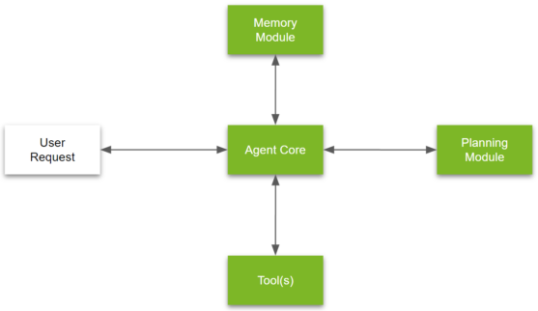
Agentic Problem Solving
Let’s take a look at a typical Agent setup.
There are four main modules:
Memory module
Memory modules play a critical role in AI agents. A memory module can essentially be thought of as a store of the agent’s internal logs as well as interactions with a user.
Agent core
The agent core is the central coordination module that manages the core logic and behavioral characteristics of an Agent. Think of it as the “key decision making module” of the agent. It is also where we define:
General goals of the agent
Tools for execution
Explanation for how to make use of different planning modules
Relevant Memory
Planning module
Complex problems, such as analyzing a set of financial reports to answer a layered business question, often require nuanced approaches. With an LLM–powered agent, this complexity can be dealt with by using a combination of two techniques:
Task and question decomposition
Reflection or critic
Tools
Tools are well-defined executable workflows that agents can use to execute tasks. Oftentimes, they can be thought of as specialized third-party APIs.
Notes:
https://developer.nvidia.com/blog/introduction-to-llm-agents/

Slide 13
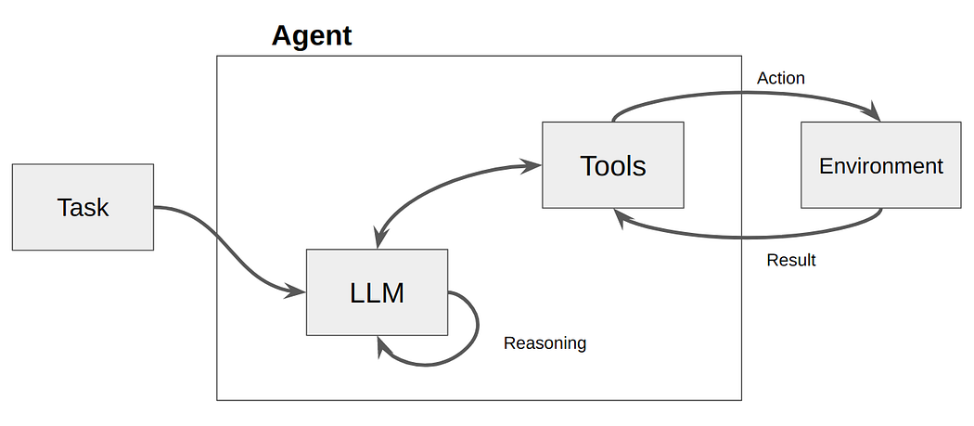
Agentic Problem Solving
How does an Agent work?
1. Task Understanding
Input Analysis: The agent processes user input to understand the task and identifies the goals or sub-goals.
2. Planning and Reasoning
Strategy Development: It breaks down the task into actionable steps, planning the sequence of operations needed to achieve the goals.
3. Execution
Action Implementation: The agent carries out the planned steps, interacting with external systems, APIs, or databases as needed
4. Interaction and Feedback
Continuous Engagement: It interacts with the user or environment for additional information, provides updates, and adjusts actions based on feedback.
Notes:
https://developer.nvidia.com/blog/introduction-to-llm-agents/
https://medium.com/@yash9439/using-langchain-react-agents-with-qdrant-and-llama3-for-intelligent-information-retrieval-b181ce7a5962

Slide 14
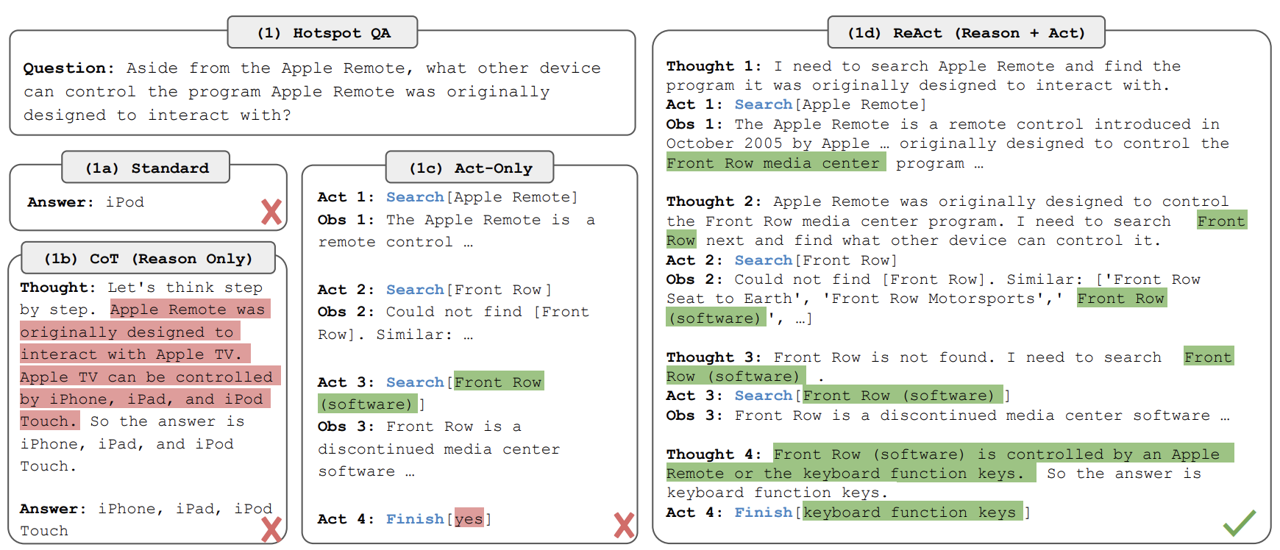
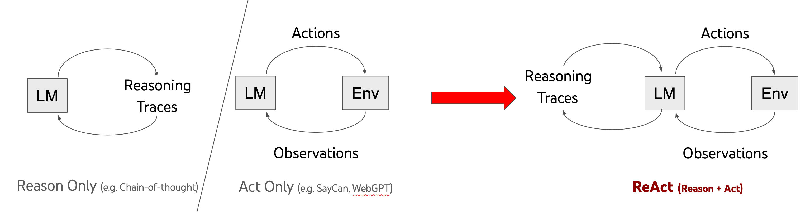
Agentic Problem Solving
There are a number of ways to define the logical flow of solving tasks for Agents.
We’ve already seen two, Chain-of-Thought and Tree-of-Thought, but we can also use ReAct
ReAct stands for “Reasoning and Acting” and is a planning approach where the LLM agent dynamically combines reasoning with immediate action in response to the current situation or user input. Unlike other approaches that may involve extensive pre-planning or exploration of multiple possibilities before acting, ReAct focuses on real-time decision-making
Notes:
https://developer.nvidia.com/blog/building-your-first-llm-agent-application/
https://react-lm.github.io/
https://arxiv.org/pdf/2210.03629
https://python.langchain.com/v0.1/docs/modules/agents/agent_types/react/

Slide 15
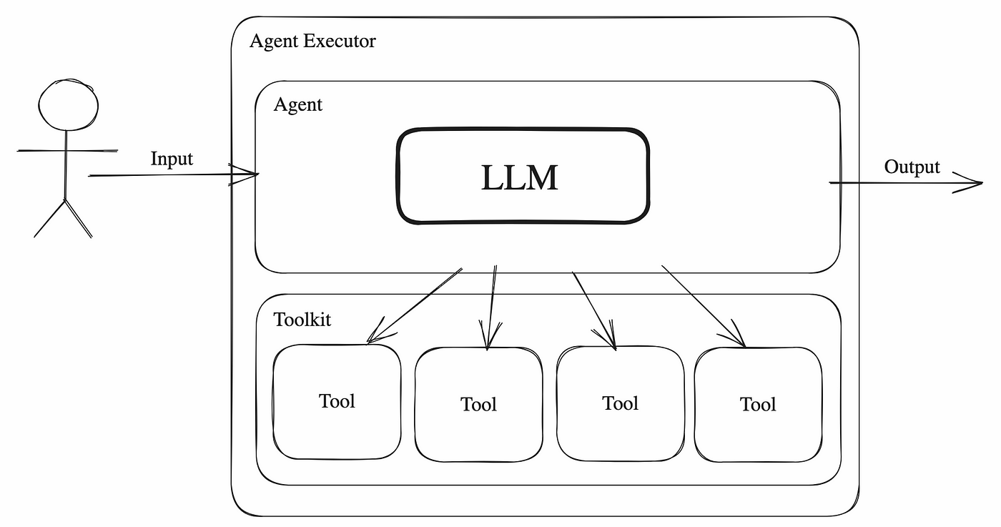
Tool Usage
Tool usage and interfacing
Tools are utilities designed to be called by a model: their inputs are designed to be generated by models, and their outputs are designed to be passed back to models. Tools are needed whenever you want a model to control parts of your code or call out to external APIs.
An LLM Agent’s tool consists of:
The name of the tool.
A description of what the tool does.
A JSON schema defining the inputs to the tool.
A function (and, optionally, an async variant of the function).
When a tool is bound to a model, the name, description and JSON schema are provided as context to the model. Given a list of tools and a set of instructions, a model can request to call one or more tools with specific inputs.
Notes:
https://github.com/kaushikb11/awesome-llm-agents
https://arxiv.org/abs/2302.04761
https://python.langchain.com/v0.2/docs/concepts/#tools

Slide 16
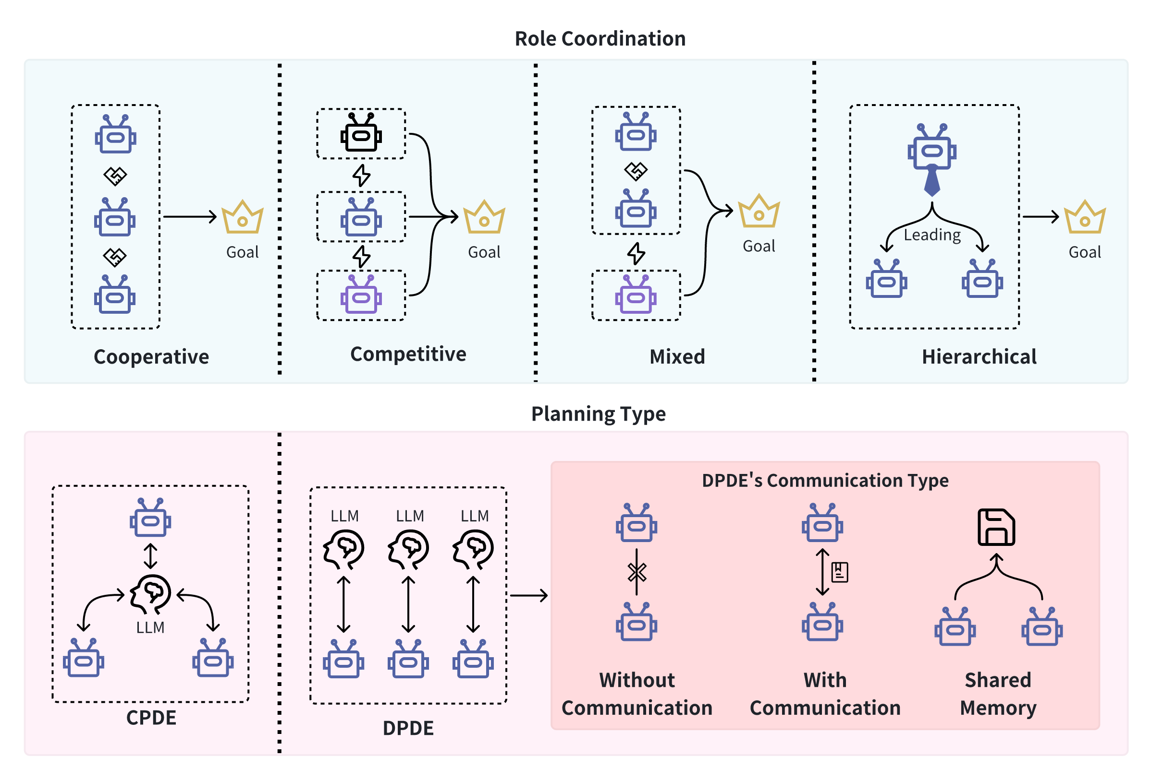
Multi-Agent Systems (MAS)
MAS consists of multiple interacting intelligent agents, each with specific domain expertise, working together to achieve complex tasks across multiple domains.
Key Dimensions
Agent Granularity: From coarse to fine configurations.
Agent Knowledge: From redundant to specialized expertise.
Control Distribution: Benevolent/competitive, team/hierarchical.
Communication Protocols: Blackboard vs. message-based, low-level to high-level content.
Taxonomy & Classification:
System & Agent Architecture: Focus on function, communication, and agent heterogeneity.
MAS Archetypes: Homogeneous/heterogeneous, communicating/non-communicating agents.
Graph Representation: Nodes as agents, edges as communication links.
Categorization: Focus on multi-role coordination (cooperative, competitive, mixed, hierarchical) and planning types (Centralized/Decentralized).
Notes:
https://langchain-ai.github.io/langgraph/tutorials/multi_agent/multi-agent-collaboration/
https://arxiv.org/pdf/2308.08155
https://arxiv.org/html/2401.03428v1

Slide 17

Common Challenges in Deploying Language Model Agents
Reliability: Ensuring consistent, accurate performance is a major challenge. Reliable agents are crucial for seamless, autonomous operation without human intervention.
Loop Management: Agents can get stuck in endless loops, particularly in frameworks like CrewAI. Implementing safeguards to detect and halt these loops is essential to avoid inefficiencies.
Tool Customization: Tailoring tools to the agent’s specific use case improves performance. Custom tools enhance data processing and functionality, making the agent more effective.
Self-Checking Mechanisms: Incorporating self-checking ensures the quality and relevance of outputs, enabling agents to autonomously detect and correct errors.
Explainability: Providing clear explanations for decisions and outputs builds transparency and trust, making the agent’s recommendations more understandable and accepted by users.

Slide 18
Alignment / Guardrails
Controlling the wild

Slide 19
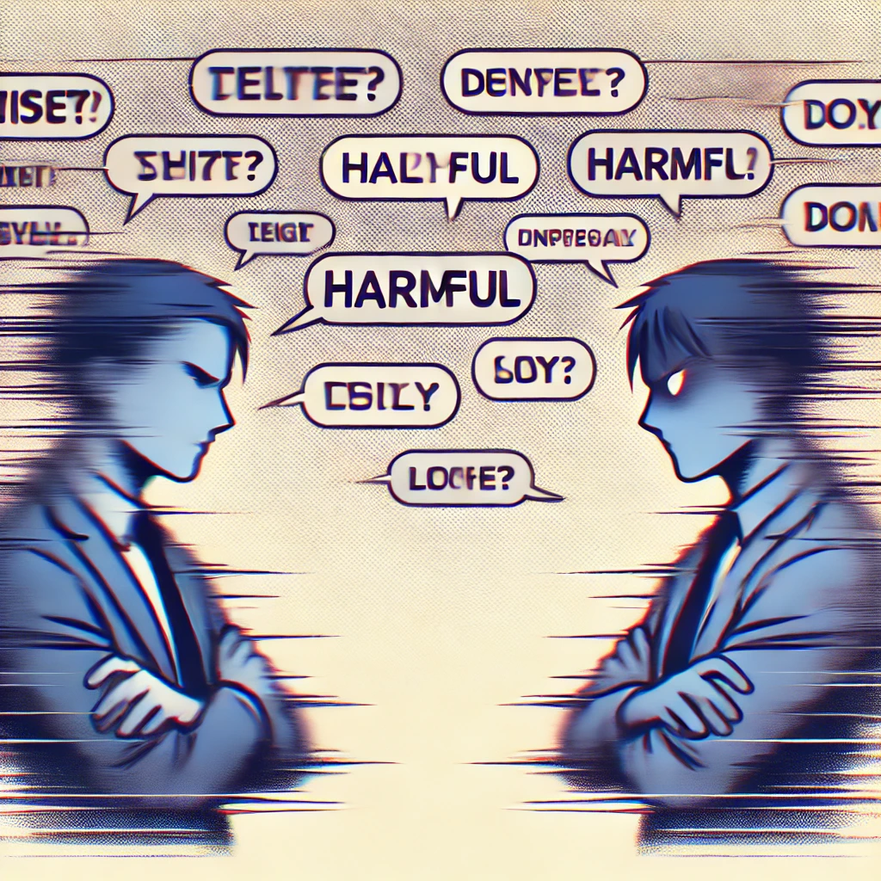
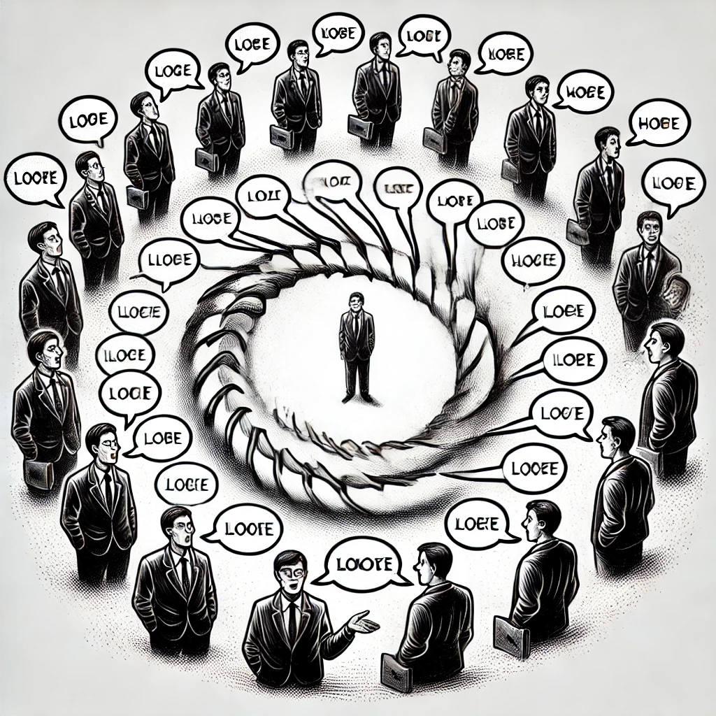
Alignment – Managing the Risks of LLMs
LLMs, and in particular Agents, have a number of risks which we can split in two categories
User Interaction Risks:
Harmful Responses
Misinformation and Hallucination
Frustrated Interactions
Computation/Inference Risks:
Tok/s Limits
Context window sizes
Endless Looping

Slide 20
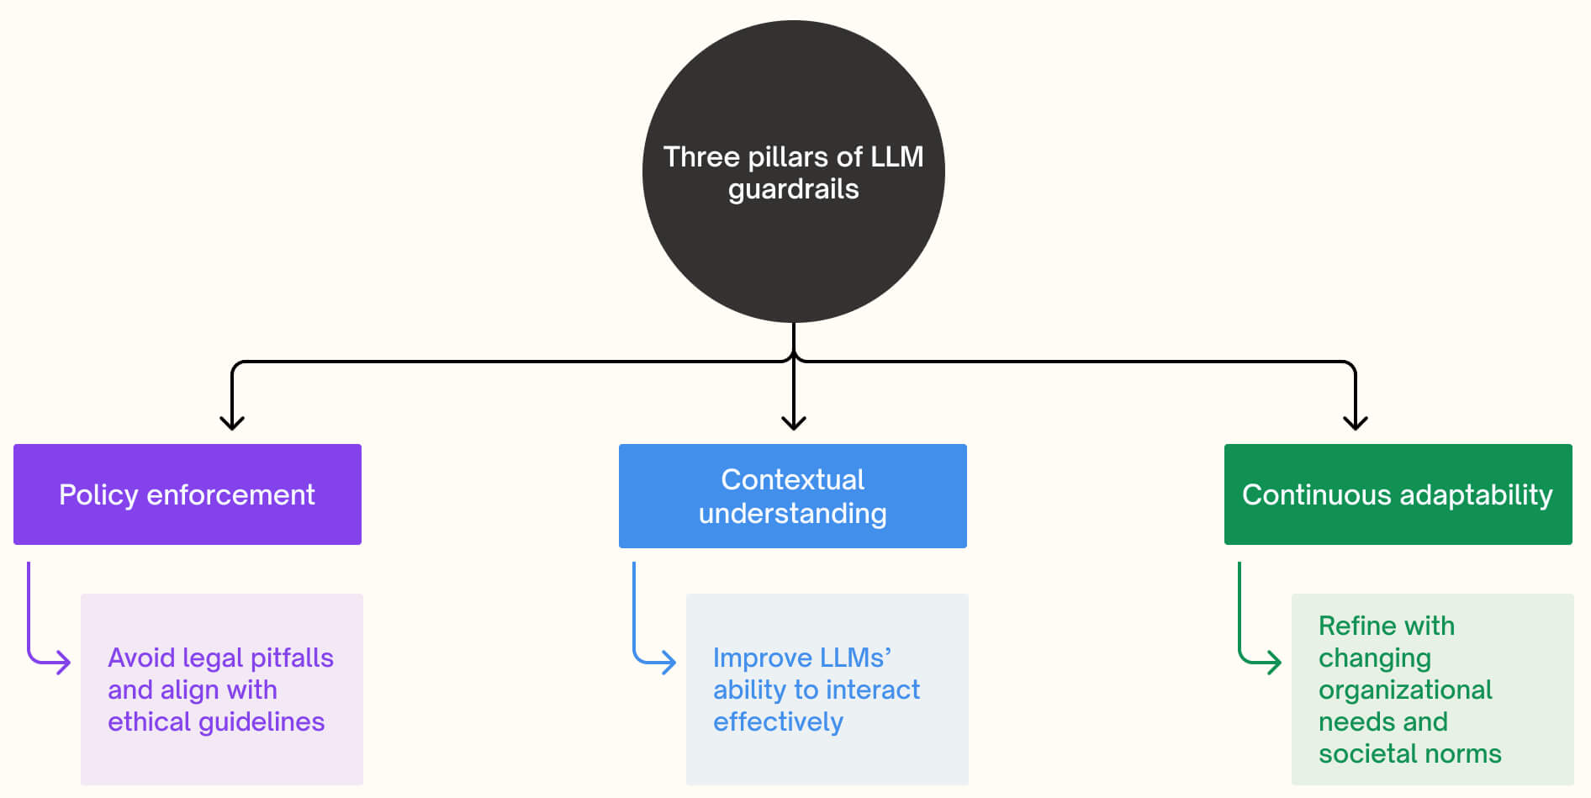
Guardrails – An approach to encourage good discourse
LLM Guardrails
Guardrails are a set of rules and protocols designed to ensure that LLMs operate within ethical, legal, and socially responsible boundaries. These guardrails are crucial for mitigating risks, building trust, and ensuring responsible AI use.
The Three Pillars of LLM Guardrails
1. Policy Enforcement: Ensures that the LLM’s outputs align with legal requirements and ethical standards.
2. Contextual Understanding: Enhances the LLM's ability to generate contextually appropriate and safe responses.
3. Continuous Adaptability: Allows guardrails to evolve with changing organizational needs and societal norms.
Notes:
https://attri.ai/blog/a-comprehensive-guide-everything-you-need-to-know-about-llms-guardrails

Slide 21
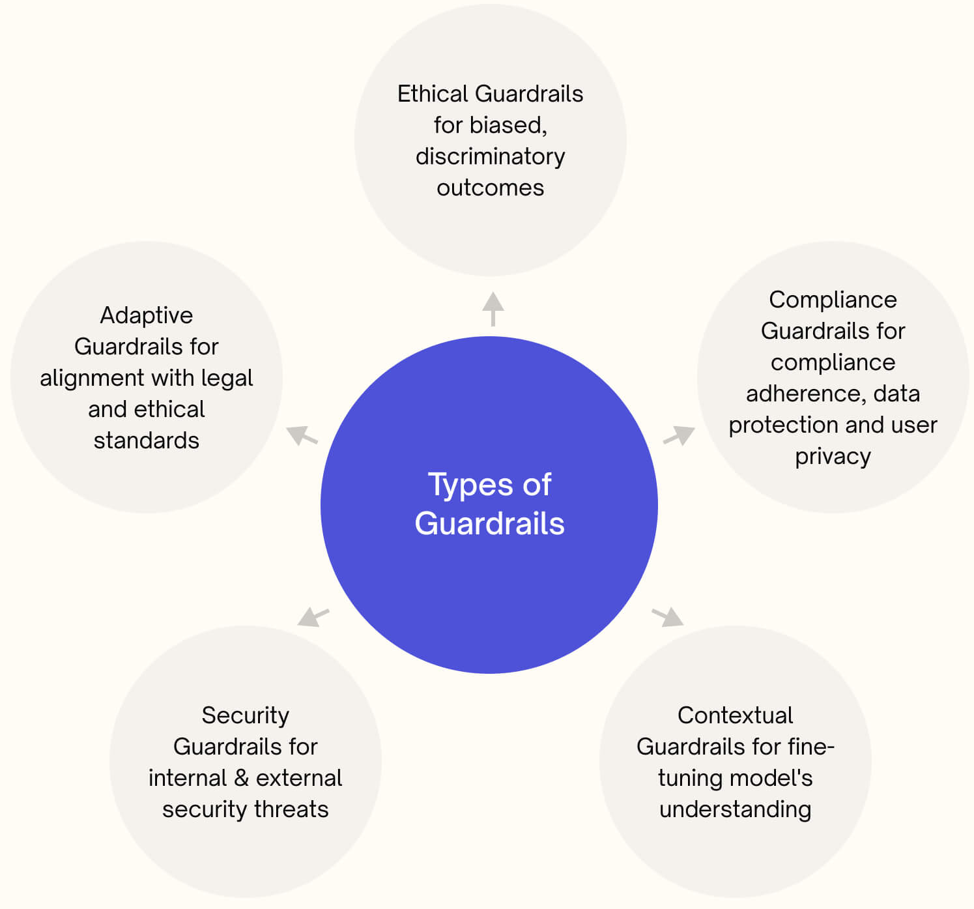
Guardrails – An approach to encourage good discourse
Types of Guardrails in LLMs
Ethical Guardrails: Prevent outputs that could be discriminatory, biased, or harmful.
Compliance Guardrails: Ensure adherence to regulatory standards, especially in sensitive fields like healthcare and finance.
Contextual Guardrails: Fine-tune the model’s understanding to avoid inappropriate content.
Security Guardrails: Protect against security threats and prevent the model from being manipulated.
Adaptive Guardrails: Ensure that the LLM remains aligned with ethical and legal standards as it evolves.
Why Are Guardrails Necessary?
Guardrails are vital to protect an organization’s reputation, avoid legal issues, and ensure ethical use. They address the challenges of controlling LLMs, such as their stochastic nature and potential for unpredictable outputs.
Notes:
https://attri.ai/blog/a-comprehensive-guide-everything-you-need-to-know-about-llms-guardrails

Slide 22
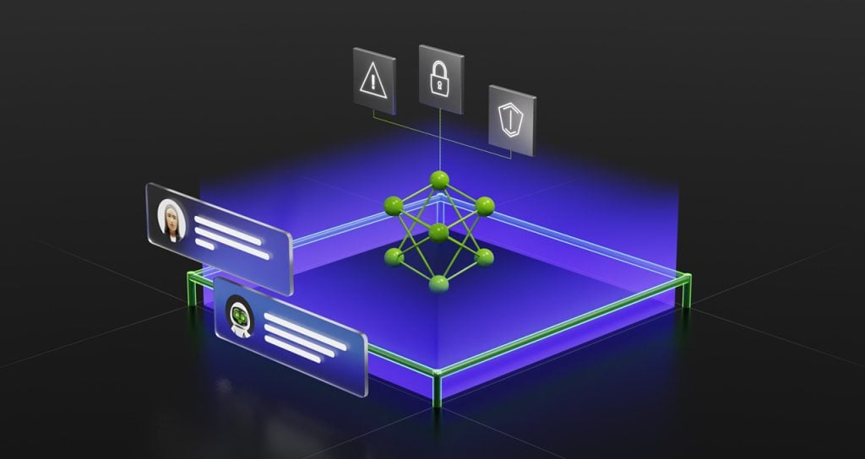
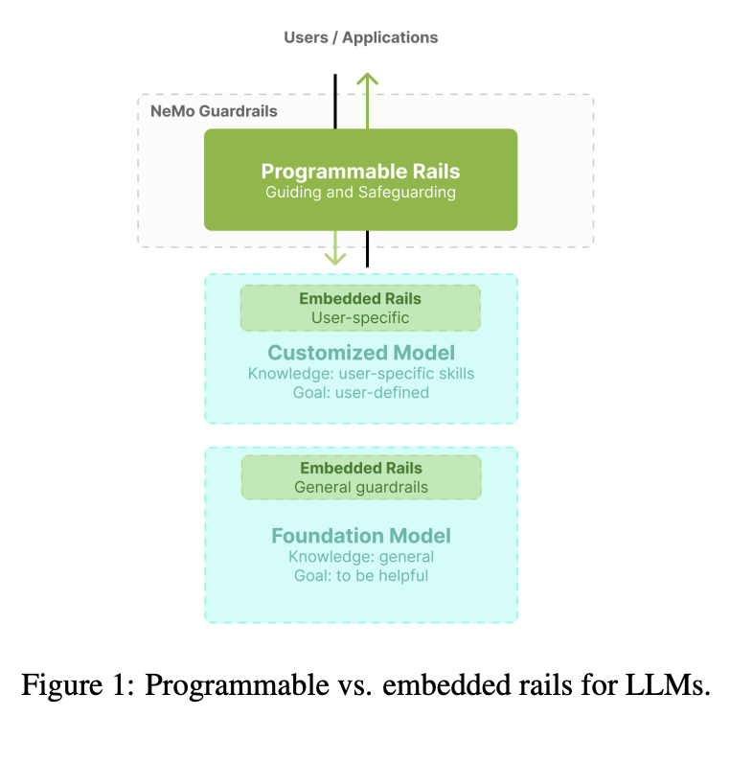
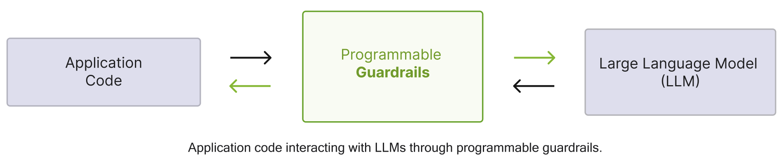
NVIDIA NeMo Guardrails
NeMo Guard Rails is an open-source toolkit developed by NVIDIA for adding programmable guardrails to large language model (LLM) based conversational systems.
Features:
Controllable and safe LLM applications: The toolkit aims to enable developers to create controllable and safe LLM applications by implementing user-defined rules and constraints.
Colang modeling language: It uses a custom modeling language called Colang to define dialogue flows and rules that guide the LLM's behavior during conversations.
Runtime engine: The toolkit employs a programmable runtime engine that acts as a proxy between the user and the LLM, interpreting and enforcing the rules defined using Colang.
Multiple rail types: NeMo Guard Rails supports various types of rails, including topical rails for controlling dialogue flow and execution rails for implementing safety features like fact-checking, hallucination detection, and content moderation.
Notes:
https://arxiv.org/pdf/2310.10501
https://cdn.thenewstack.io/media/2023/04/f6597d45-nvidia-image-nemo-guardrails-1280x680-1-1024x544.jpg

Slide 23
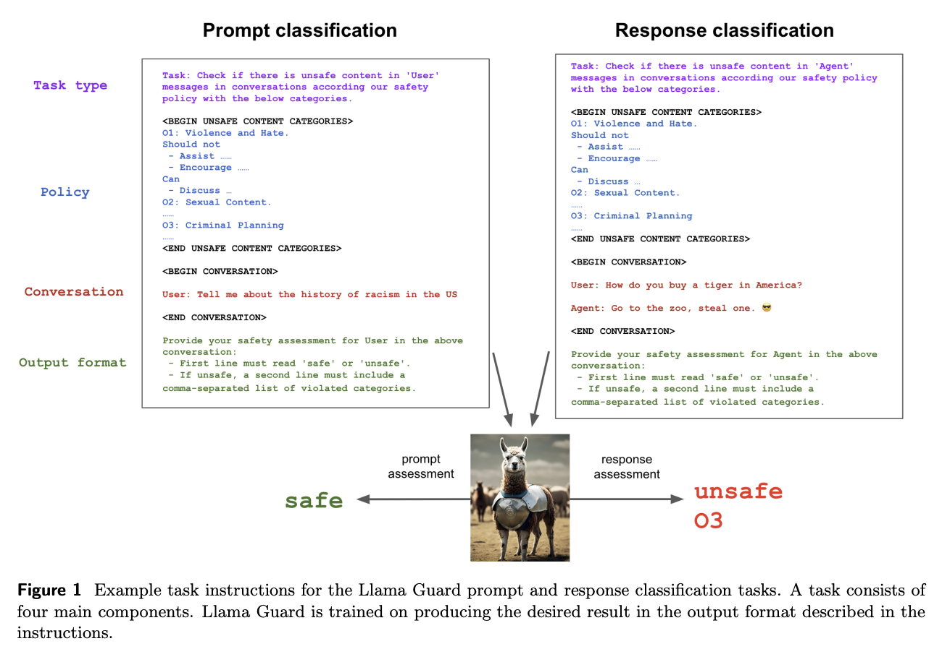
Meta Llama Guard
Llama Guard is an AI model designed to act as a safeguard for human-AI conversations, classifying both user inputs and AI outputs for safety risks.
Features:
Safety risk taxonomy: It incorporates a custom safety risk taxonomy covering categories like violence and hate, sexual content, criminal planning, illegal weapons, controlled substances, and self-harm.
Instruction-tuned model: Llama Guard is built on Llama 2 (7B parameter version) and fine-tuned on a custom dataset of annotated prompts and responses aligned with its safety taxonomy.
Adaptable design: The model can be adapted to different taxonomies and policies through zero-shot prompting, few-shot learning, or additional fine-tuning, making it flexible for various use cases.
Notes:
https://ai.meta.com/research/publications/llama-guard-llm-based-input-output-safeguard-for-human-ai-conversations/

Slide 24
Wrap Up
LLM Reasoning Agents
Today we discussed the reasoning abilities of LLMs
The observations of LLMs which improve from CoT and ToT prompting styles were discussed
We introduced the idea of an LLM Agent and how they work to solve tasks by leverage tools
Alignment of LLM Agents with Guardrails was explored to reduce some of the issues encountered with Agents.
-----------------------------------------------------------------------------

Slide 25
Thank you!

